Slide 1
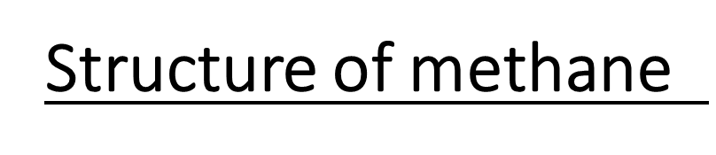
Hybridization

Slide 2
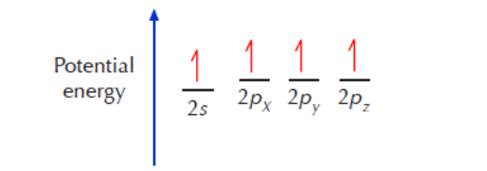
In order to achieve the octet rule, carbon must use its 4 valence electrons when bonding to other atoms.
However, only unpaired electrons can bond. That means that the two paired electrons occupying the 2s orbital must become unpaired before they can bond. Since the energy gap between the 2s and 2p orbitals is very small, one of the 2s electrons can be promoted to the empty 2p orbital, leading to the following situation:

Slide 3
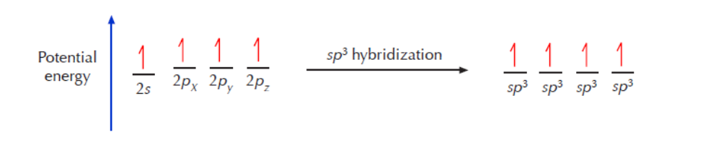
The process that leads to their formation is called sp3 hybridization
All four sp3 orbitals that result from this process are equivalent. That means that they have the same size, shape, and energy. According to VSEPR (valence shell electron pair repulsion) theory, such orbitals will orient themselves in 3-D space to be as far apart from each other as possible. The resulting shape is then a tetrahedron, where the carbon nucleus is at the center and the orbitals point to the corners of the tetrahedron

Slide 4
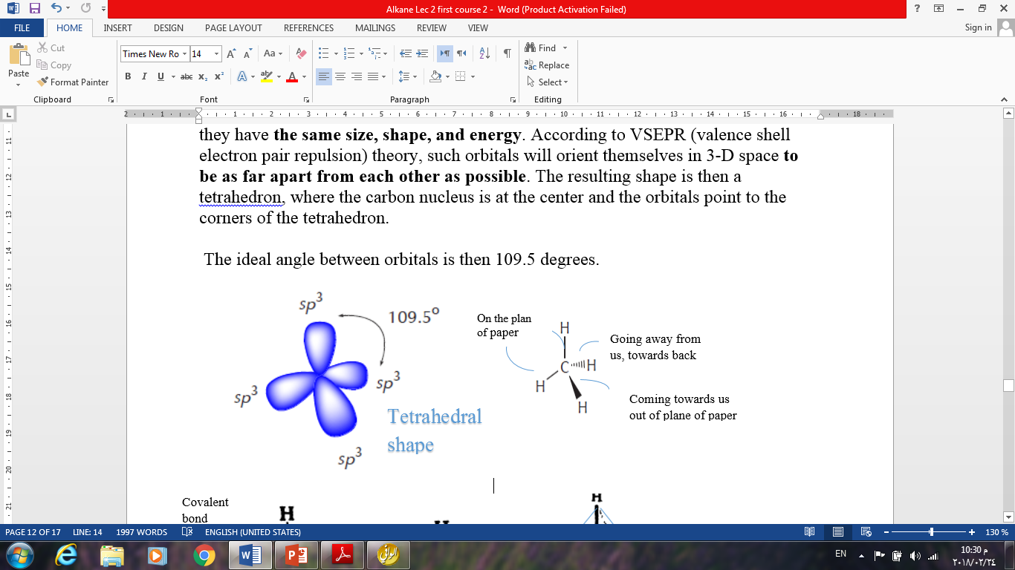
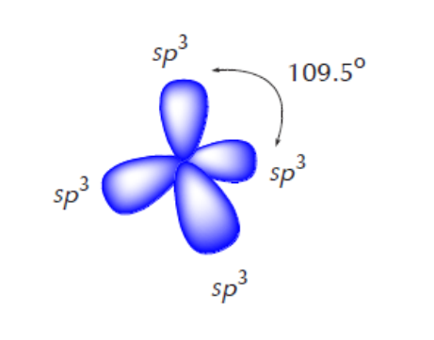

The ideal angle between orbitals is then 109.5 degrees.

Slide 5
Physical properties of methane
Methane is non-polar compound.
Attraction between non-polar molecules is van der Waals forces, which is weak interaction compared with ionic attraction between sodium and chloride ions.
Methane is colorless gas, when liquefied is less dens than water.
Slightly soluble in water, but very soluble in organic liquids as gasoline, ether and alcohol.

Slide 6
Source
Methane is product of an aerobic (without air) decay of plant, breakdown of certain very complicated molecules.
Methane is the major constituent of natural gas (up to 97%).

Slide 7
Reactions of methane
Because of the inert nature of methane, therefore, it reacts only with the highly reactive substance or under very vigorous conditions.
1-Oxidation, Heat of combustion
Methane like other hydrocarbons subjected to combustion (burning of natural gas) by flame to form carbon dioxide and water. The quantity of heat released (213 Kcal/mol).

Slide 8
Heat of combustion, the quantity of heat evolved when one mole of a hydrocarbon is burned to carbon dioxide and water, for methane its value is 213 kcal.

Slide 9
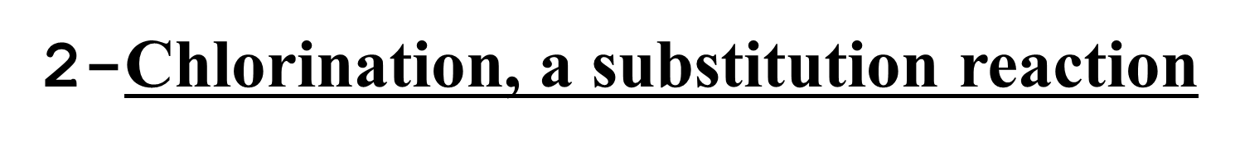
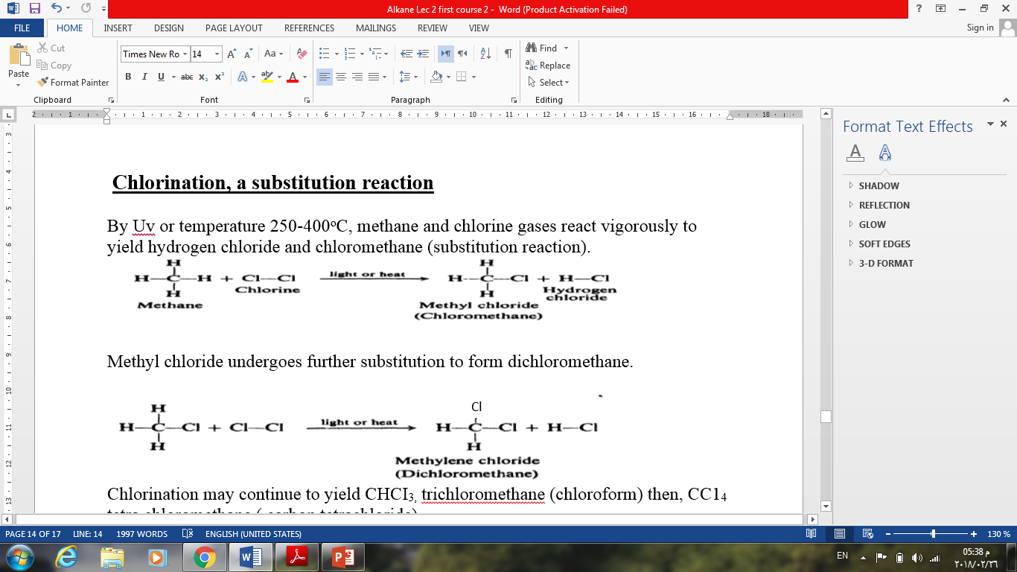

Slide 10
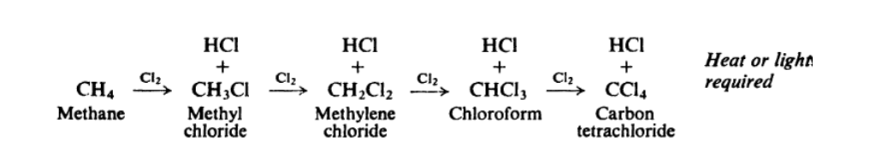
Chlorination may continue to yield CHCI_{3,} trichloromethane (chloroform) then, CC1₄ tetra chloromethane ( carbon tetrachloride).

Slide 11
Structure of Ethane

Slide 12
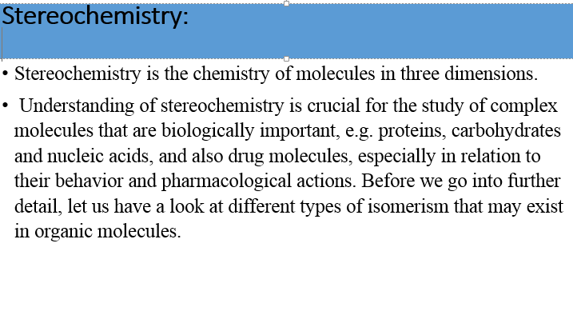

Slide 13
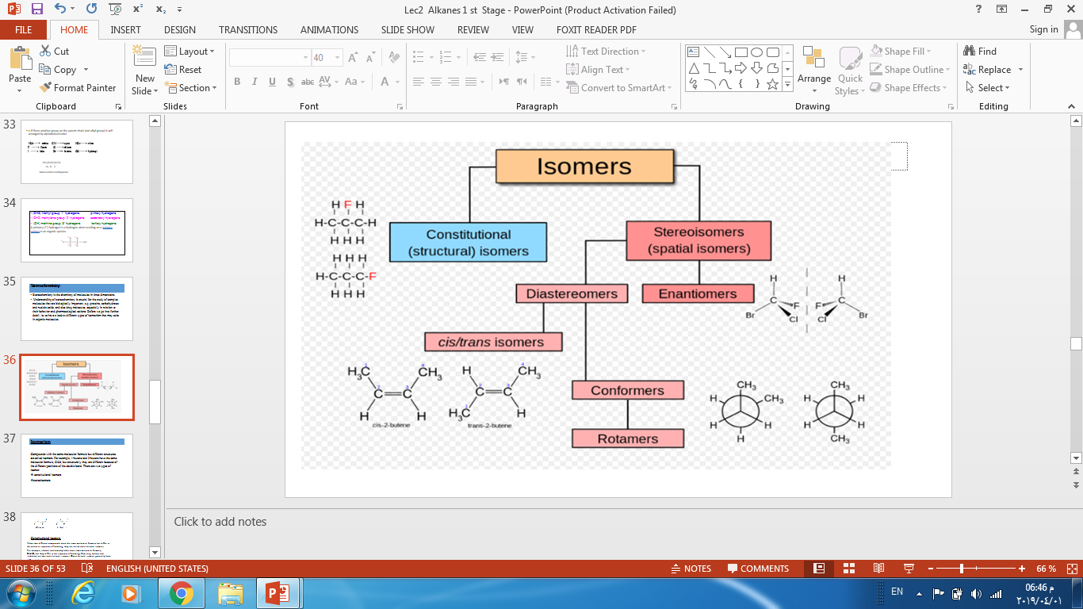

Slide 14
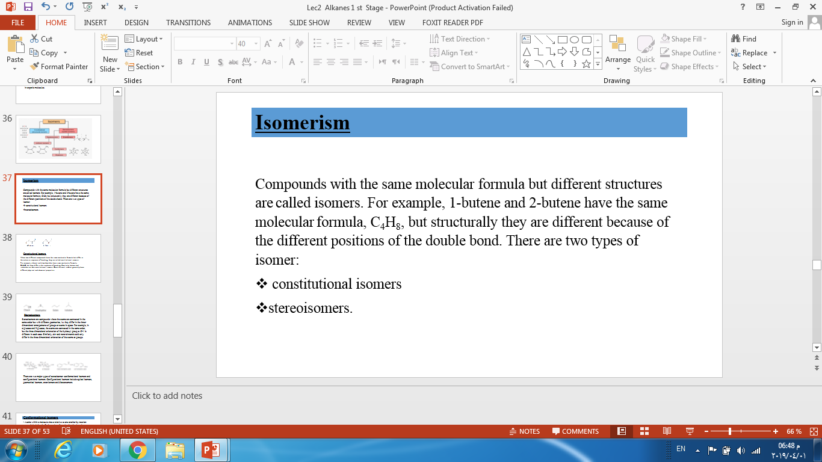

Slide 15
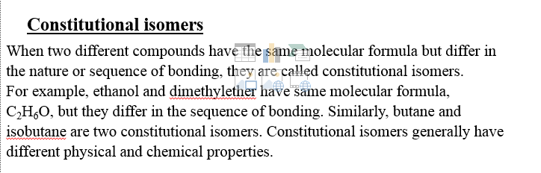

Slide 16
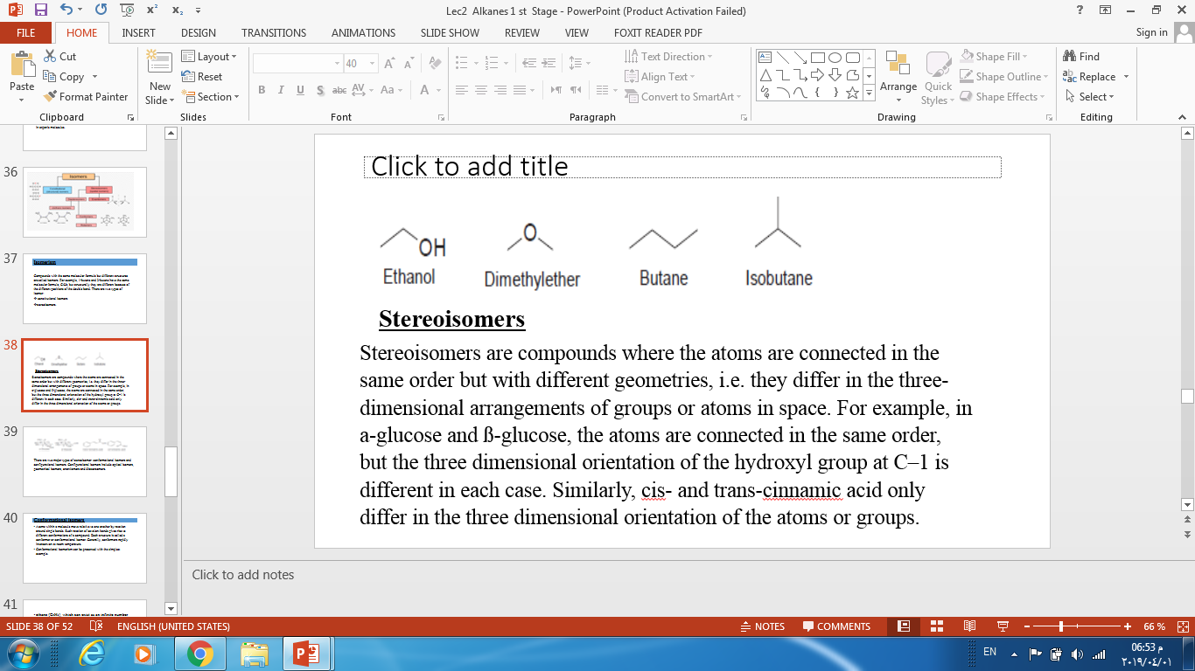

Slide 17
There are two major types of stereoisomer: conformational isomers and configurational isomers. Configurational isomers include optical isomers, geometrical isomers, enantiomers and diastereomers.

Slide 18
Conformational isomers
Atoms within a molecule move relative to one another by rotation around single bonds. Such rotation of covalent bonds gives rise to different conformations of a compound. Each structure is called a conformer or conformational isomer. Generally, conformers rapidly interconvert at room temperature.
Conformational isomerism can be presented with the simplest example.

